Slide 1
Research on Trust Level Warning System
in Vehicular Ad-hoc Network
Name: Jingyue Chen
Student number: 3035249162
Supervisor : Dr. Lucas C.K. Hui

Slide 2
Introduction
This MSc project is aimed to improve the ability for driverless vehicle inside of ad-hoc vehicular network .
In this project, I compare three different method via three type of maps with three variable scenarios.
I set up two criterias to evaluate the advantage and disadvantage of the trust level warning system.

Slide 3
Contribution
Most of the previously research of trust level warning system set up the system by giving every test vehicle a value to judge it trust or not.
I collect three simple method to do the verification of a warning message and give out a evaluation report for each method and the applicable scope of each method.

Slide 4
Difficulties
Environment configuration
From the simple map to the real map the dimension of the simulation has been increased.
By the complexity of the simulation map, there are more choices for test vehicles to avoid the crash position. The more the possibilities are the more complicated result I got.

Slide 5
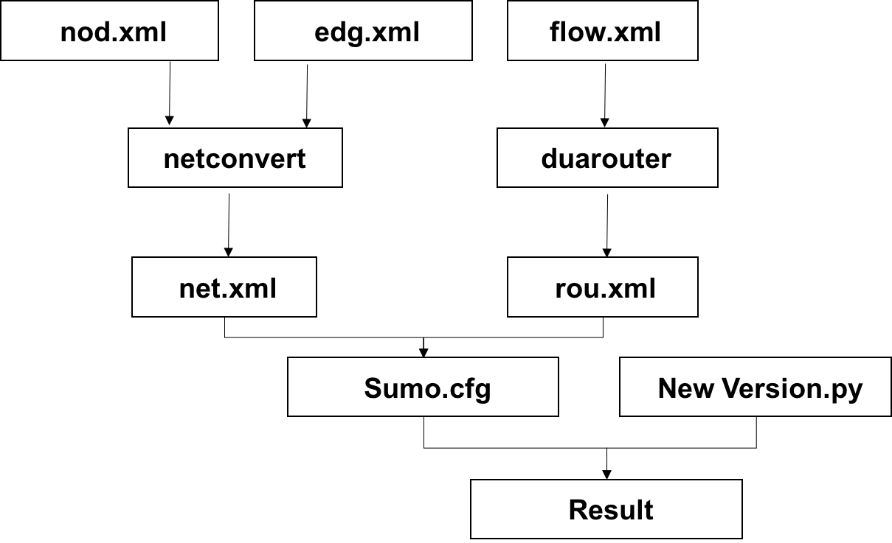
Simulation of Urban Mobility

Slide 6
Trust level warning system
the test vehicle fall into a traffic crash
send a positive verifier to the system
System meets its threshold
System broadcasts a warning message
rear test vehicle receive the warning message
I set up this trust level warning system by giving every warning message a value to judge it trust or not.

Slide 7
Three test scenarios
Situation without the collusion team of malicious users
A fake positive warning message created by collusion team
A fake negative warning message created by collusion team

Slide 8
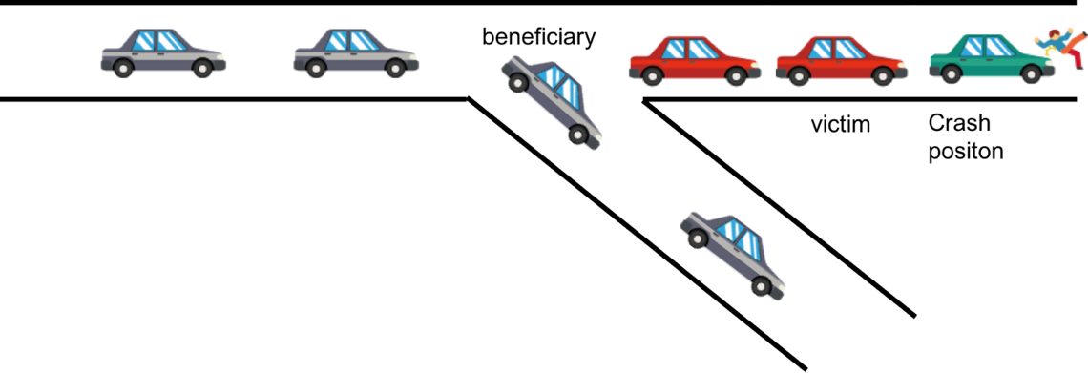
Situation without the collusion team of malicious users
No collusion team of malicious users
Real traffic crash exit in simulation map
No fake warning broadcast in the simulation system

Slide 9
Situation without the collusion team of malicious users

Slide 10
Situation without the collusion team of malicious users
crash

Slide 11
Situation without the collusion team of malicious users
verifier
verifier
verifier

Slide 12
Situation without the collusion team of malicious users
warning verified
first beneficiary

Slide 13
Situation without the collusion team of malicious users
Crash finish

Slide 14
Situation without the collusion team of malicious users

Slide 15
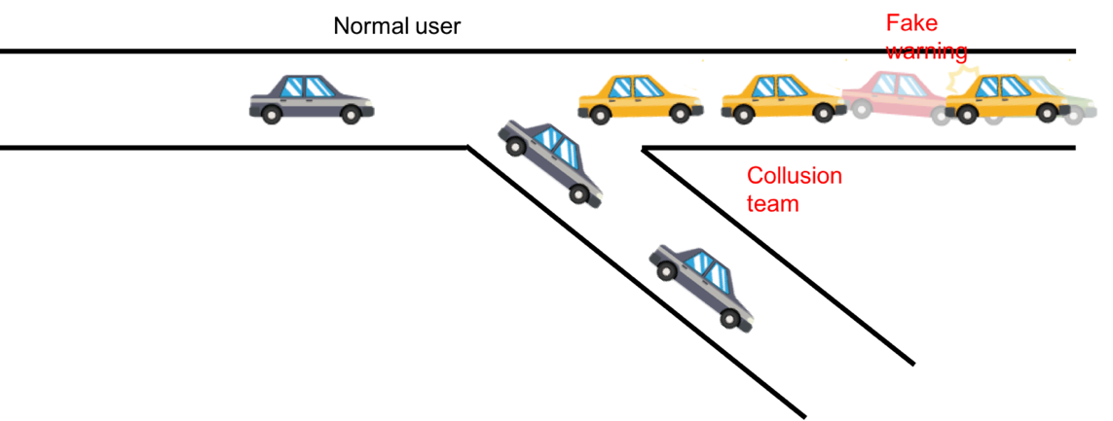
A fake positive warning message created by collusion team
There is a collusion team with malicious users
No traffic crash exit in simulation map
Fake positive warning broadcast in the simulation system

Slide 16
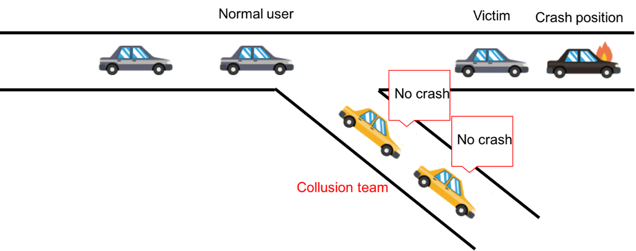
A fake negative warning message created by collusion team
There is a collusion team with malicious users
A real traffic crash exit in simulation map
Fake negative warning broadcast in the simulation system

Slide 17
A fake warning created by collusion team

Slide 18
A fake warning created by collusion team
warning
warning
warning

Slide 19
A fake warning created by collusion team
Fake warning

Slide 20
A fake warning created by collusion team
???????
???????
??????

Slide 21
Three test maps
Simple map (triangle map and roundabout map)
Block map
Real map

Slide 22

Simple map

Slide 23
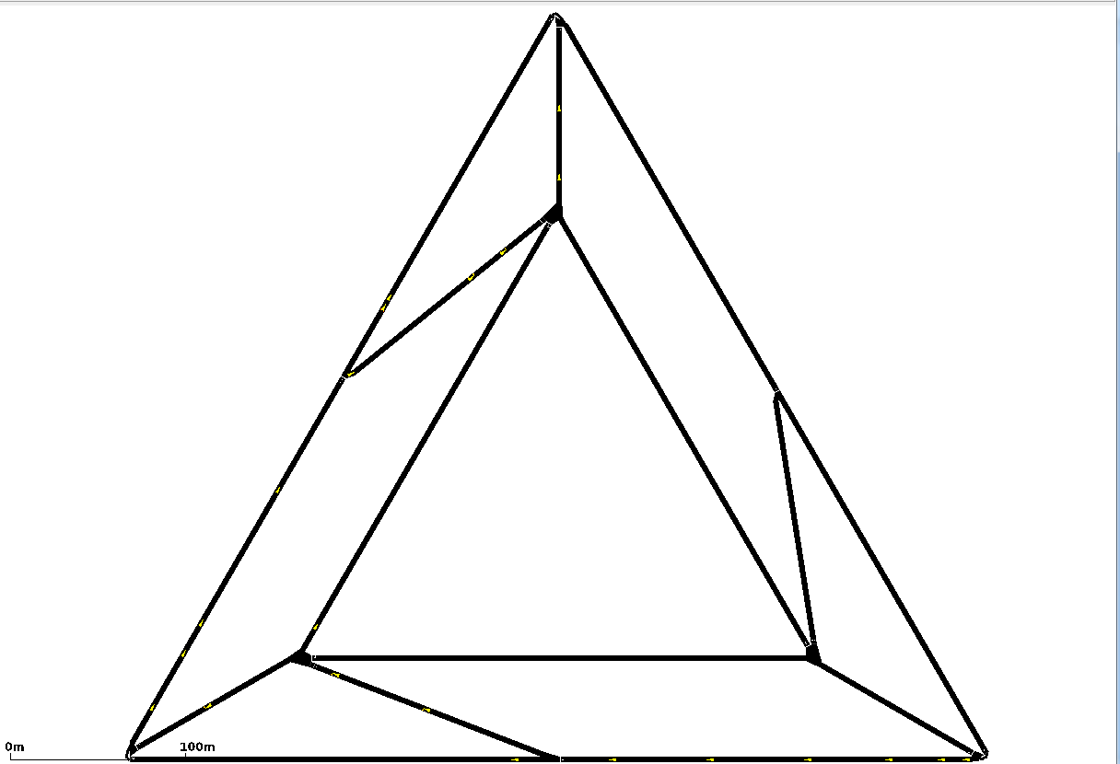
Simple map－－ Triangle road

Slide 24
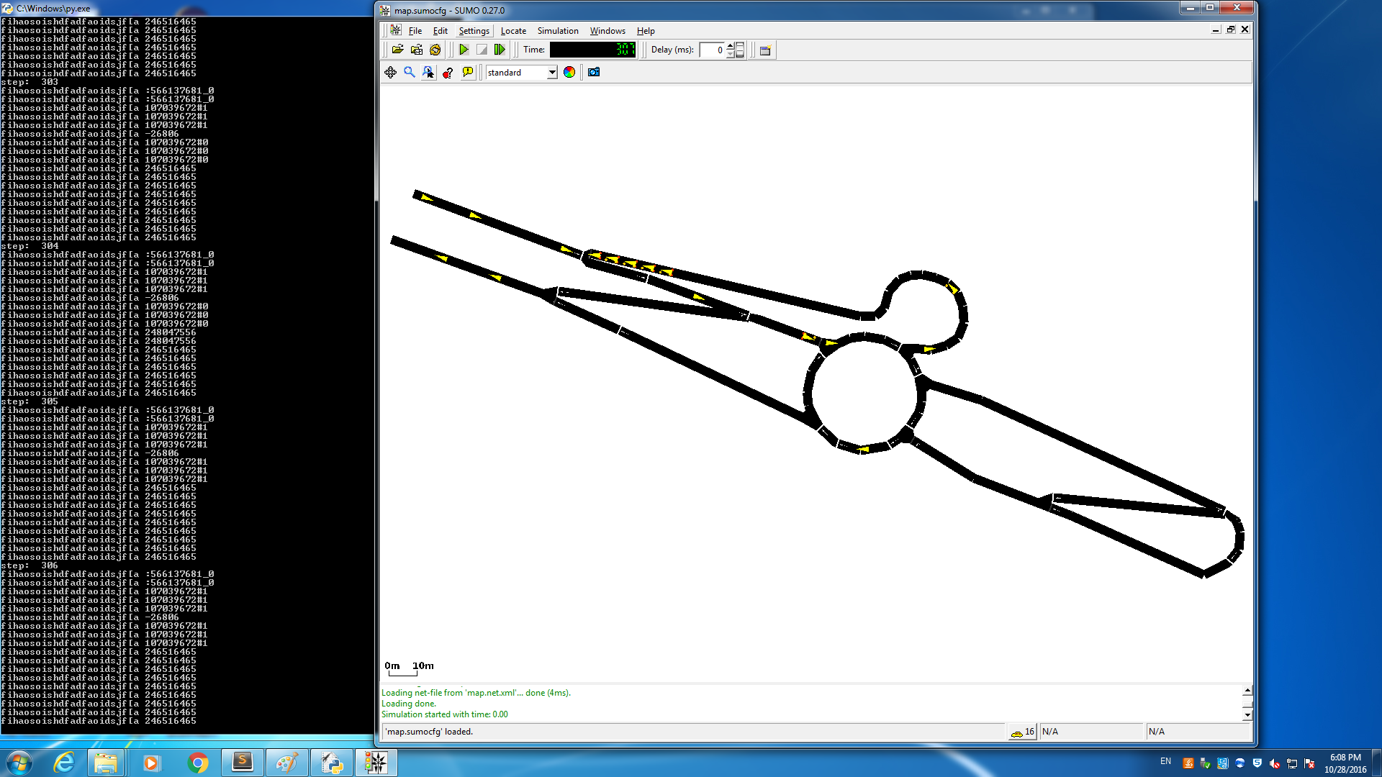
Simple map－－ Roundabout road

Slide 25
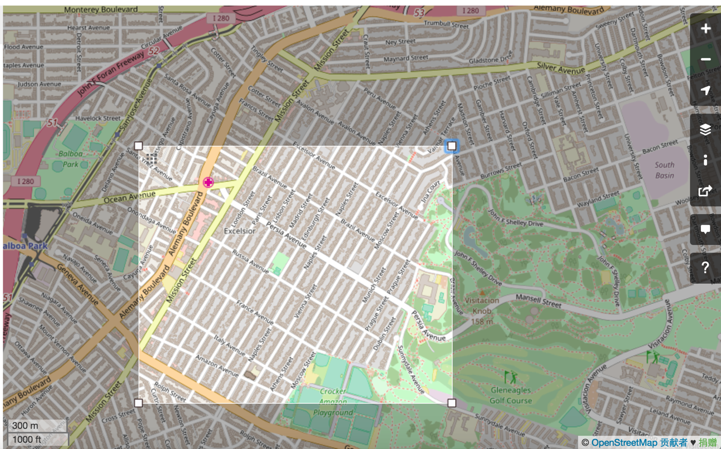
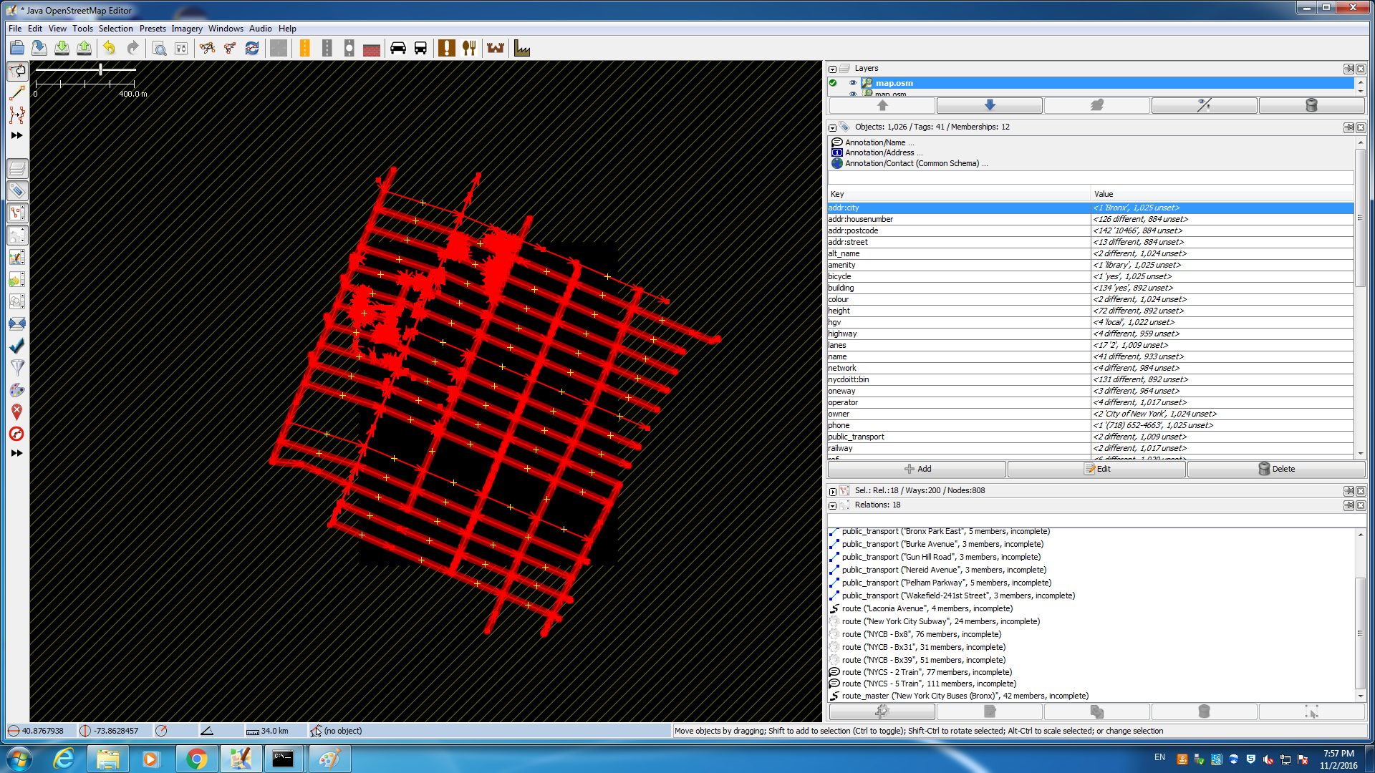
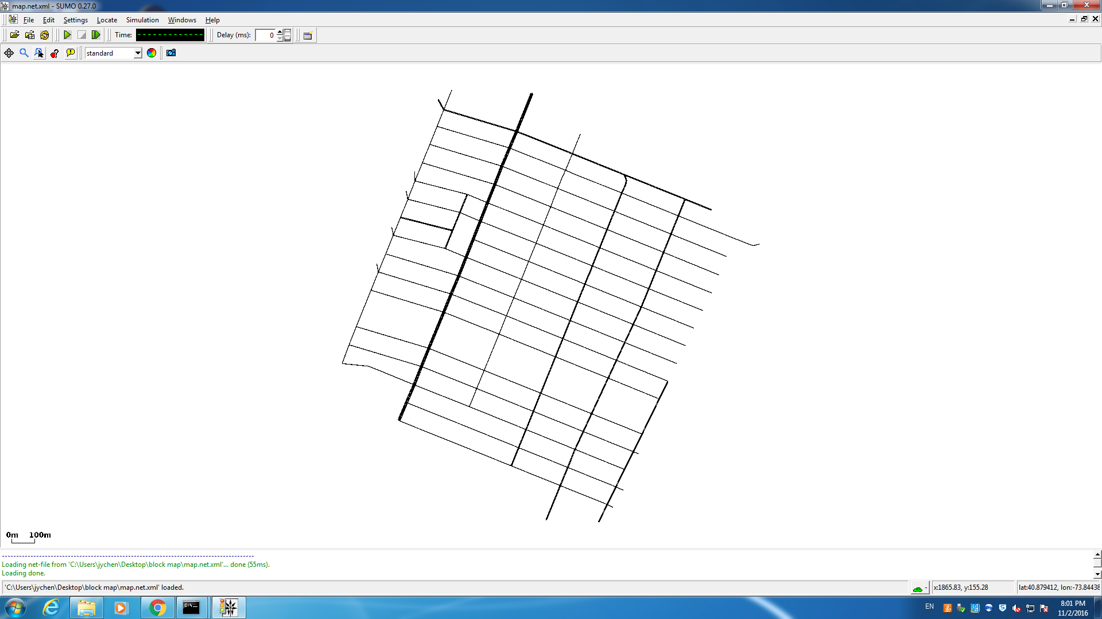
Block map

Slide 26
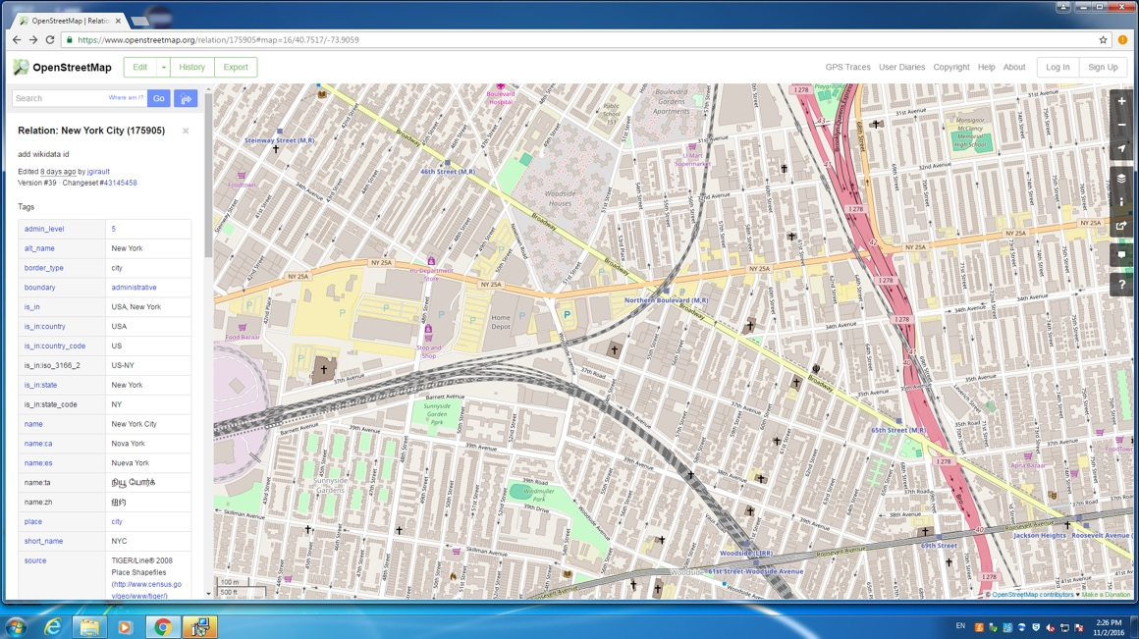
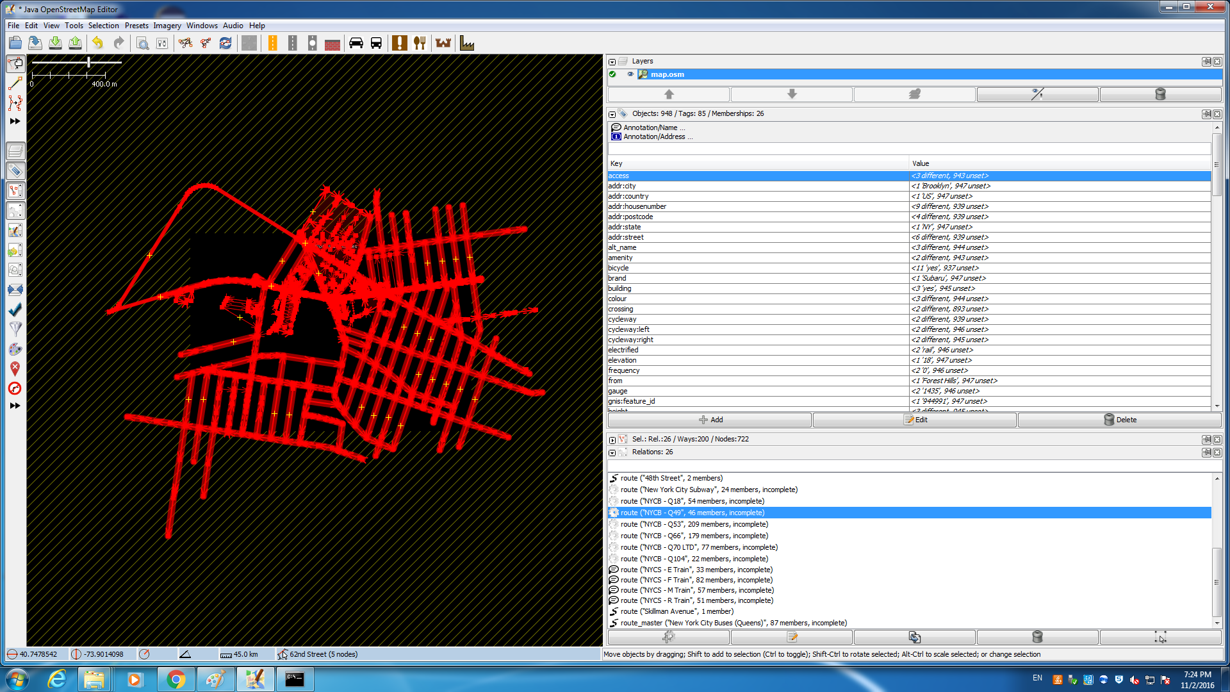
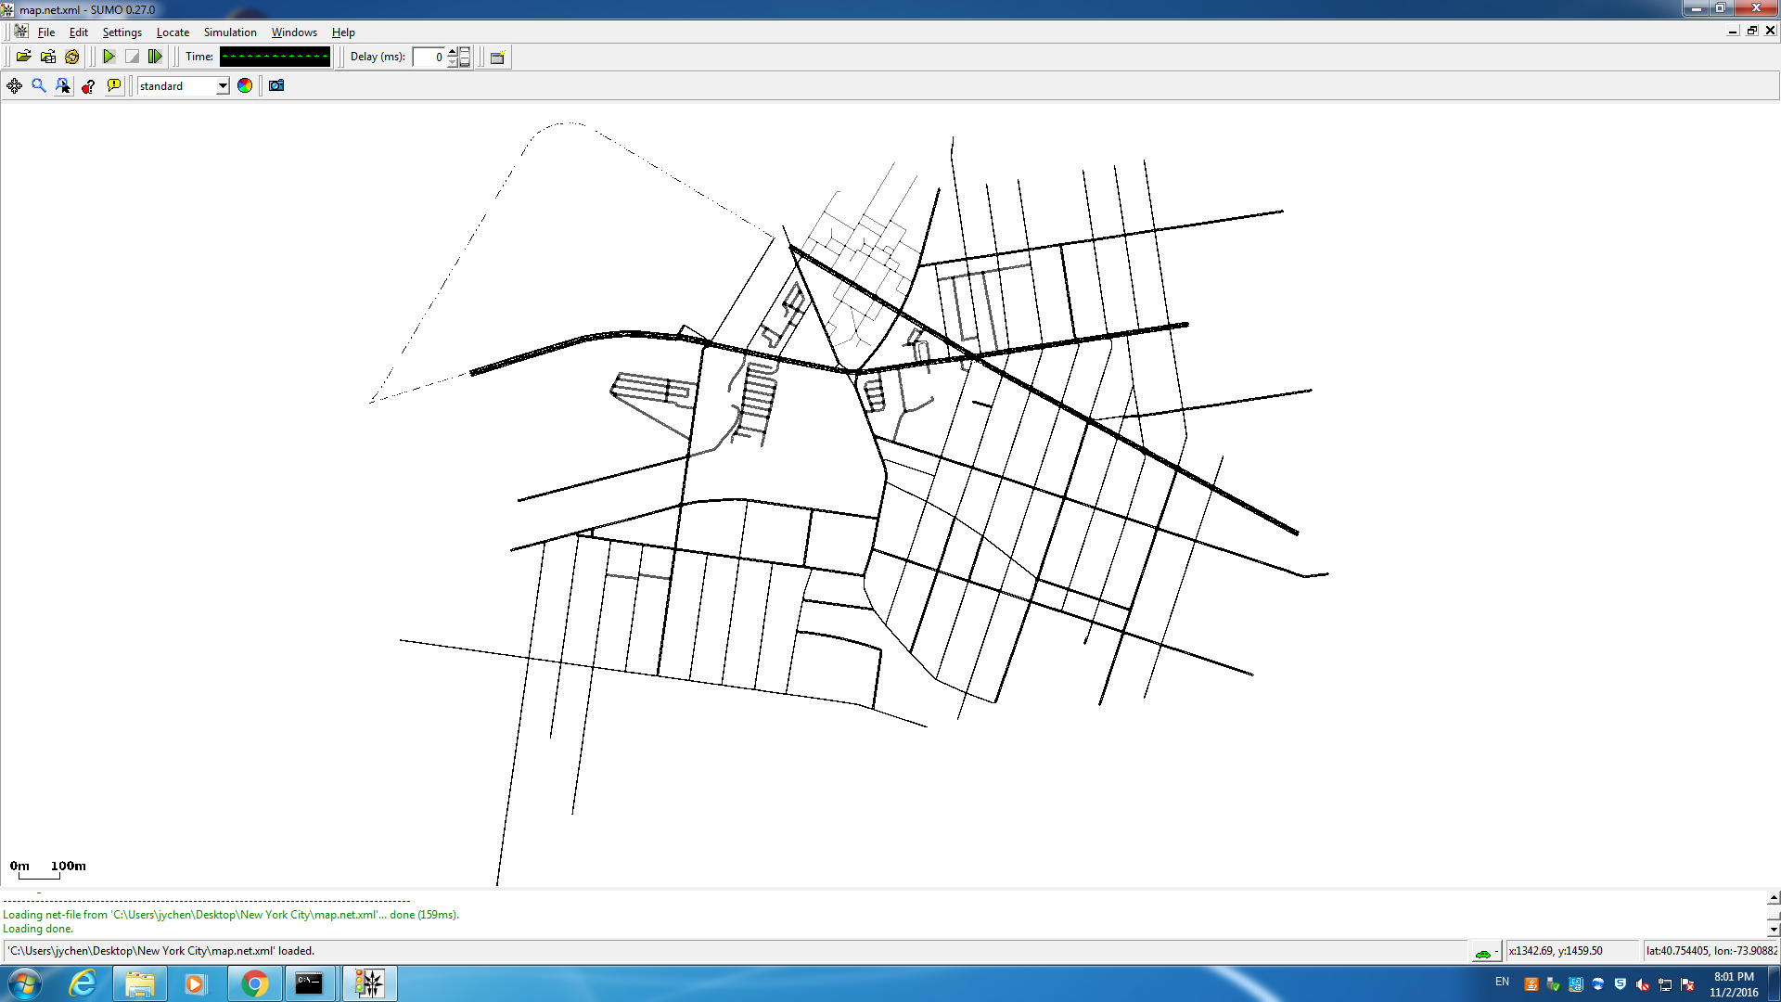
Real map

Slide 27
Summary of three types of maps
Parameters | Simple map simulation | Block map simulation | Real map simulation
Map type | Simple map | Block map | Real Map
Number of road | 3 | 200 | 200
Number of intersections | 1 | 100 | 100
Number of vehicles | 100 | 100/200/500 | 100/200/500
Vehicle speed | 0 ~ 69.5 km/h | 0 ~ 69.5 km/h | 0 ~ 69.5 km/h
Simulation time | 300s | 550s | 750s
Detection radius | 100 m | 1000 m | 1000 m
Red signal lasting time | N/A | N/A | 0 ~ 2.5s
The probability of running red lights | N/A | N/A | 20% ~ 25%

Slide 28
Algorithm to do the project
Threshold method
Parallel threshold method
Conditionality distinguishable pseudo identities approach[n,p]

Slide 29
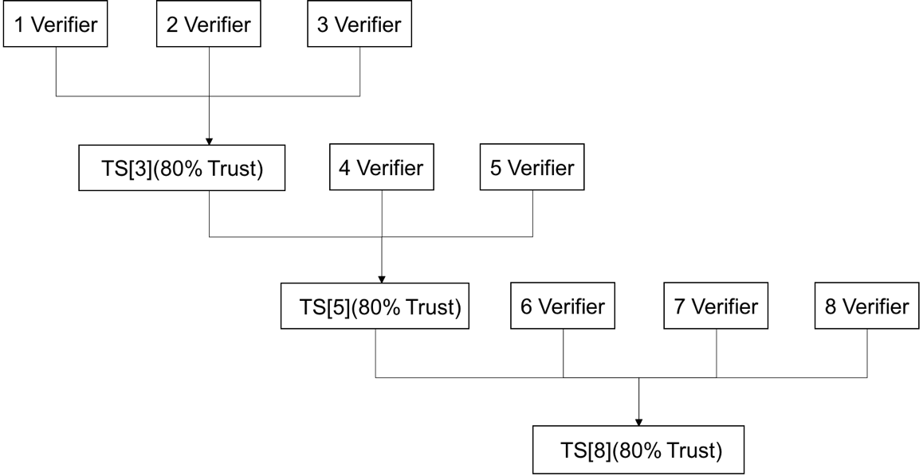
Threshold Method TS[n]

Slide 30
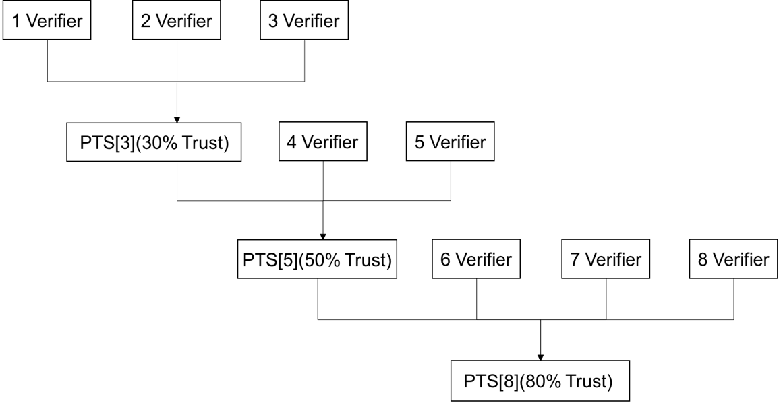
Parallel Threshold Method［x, y, z］

Slide 31
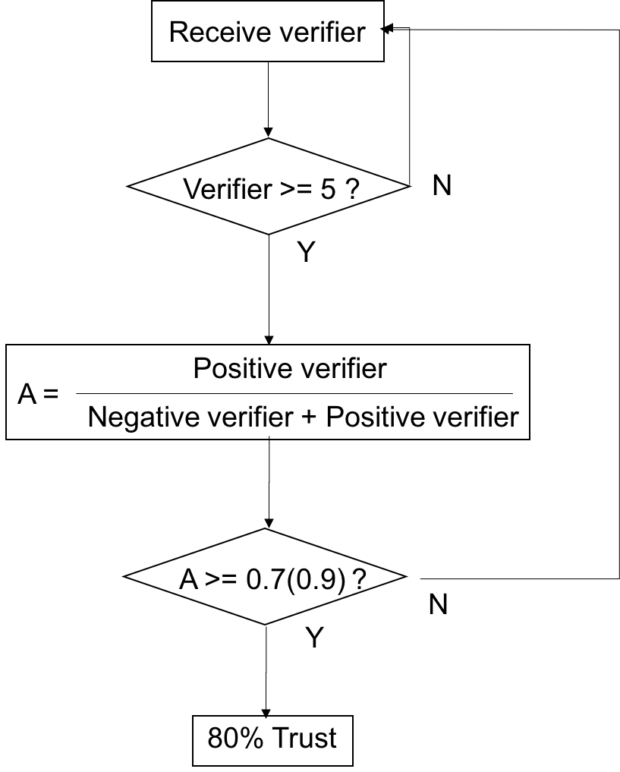
Conditionality distinguishable pseudo identities approach[n,p]

Slide 32
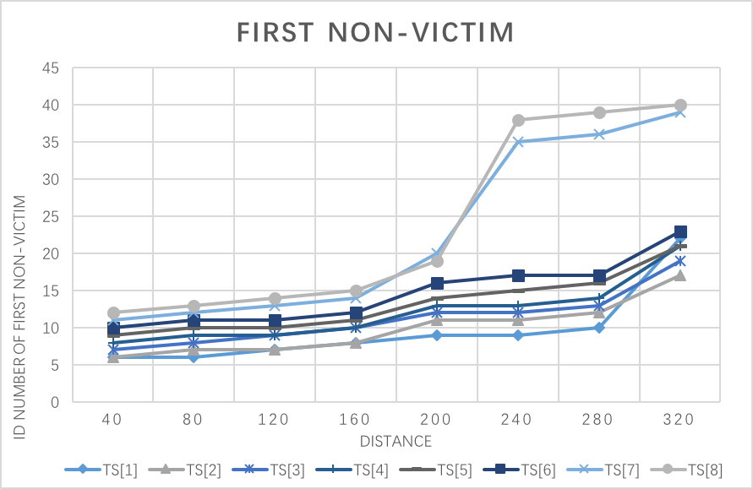
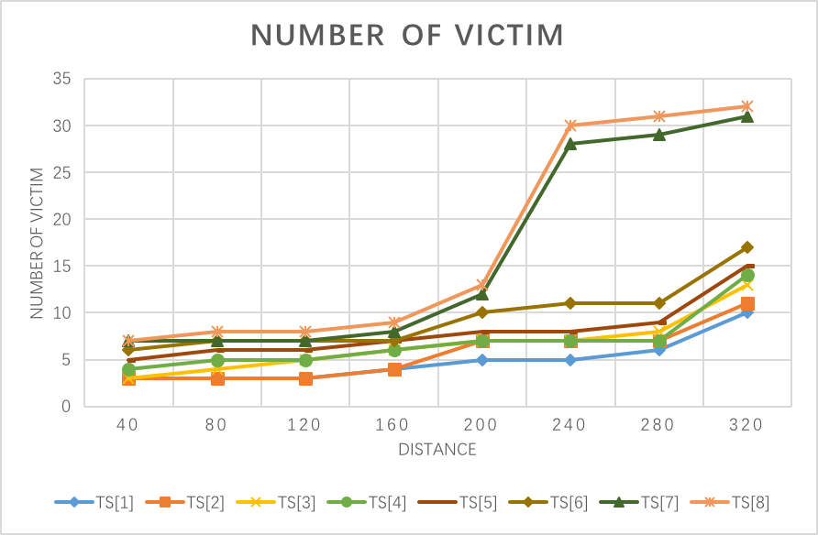
Selection of threshold for each method

Slide 33
Result of simple map－－scenario one
Number of road | 3
Number of intersection | 1
Number of normal vehicles | 100
Number of crash generator | 1
Number of malicious users | 0
Situation in the simulation | None
Crash duration time | Whole simulation
Percentage of the verified warning | 80%

Slide 34
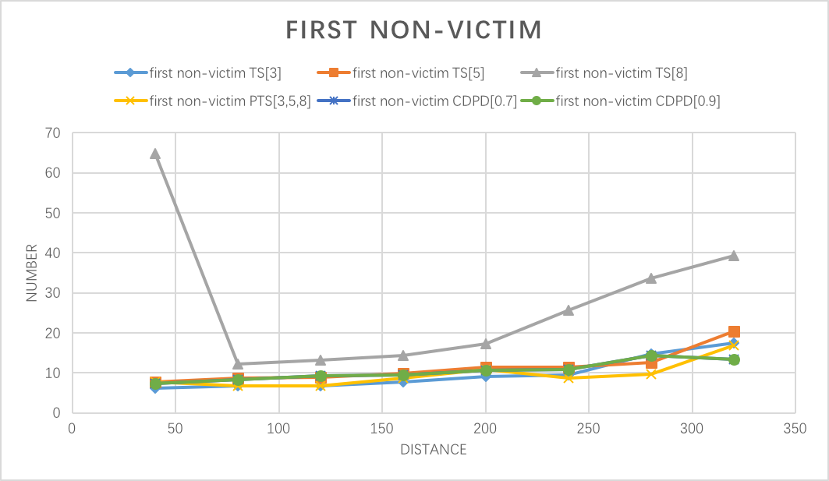
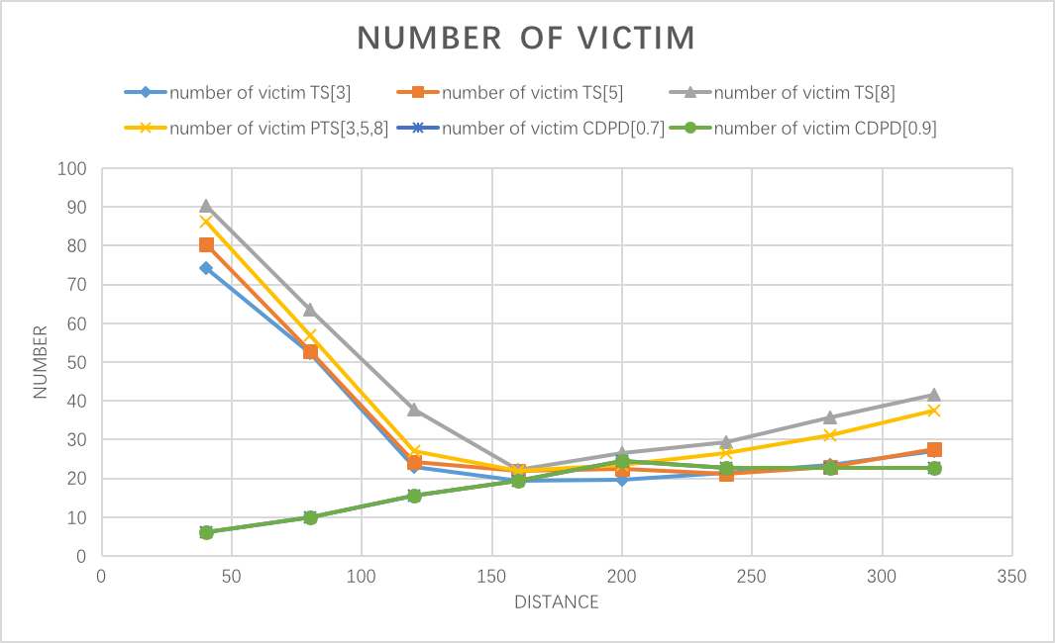
Result of simple map－－scenario one

Slide 35
Result of simple map－－scenario two
Number of road | 3
Number of intersection | 1
Number of normal vehicles | 100
Number of crash generator | N/A
Number of malicious users | 1 ~ 10
Situation in the simulation | Fake positive warning
Crash duration time | N/A
Percentage of the verified warning | 80%

Slide 36
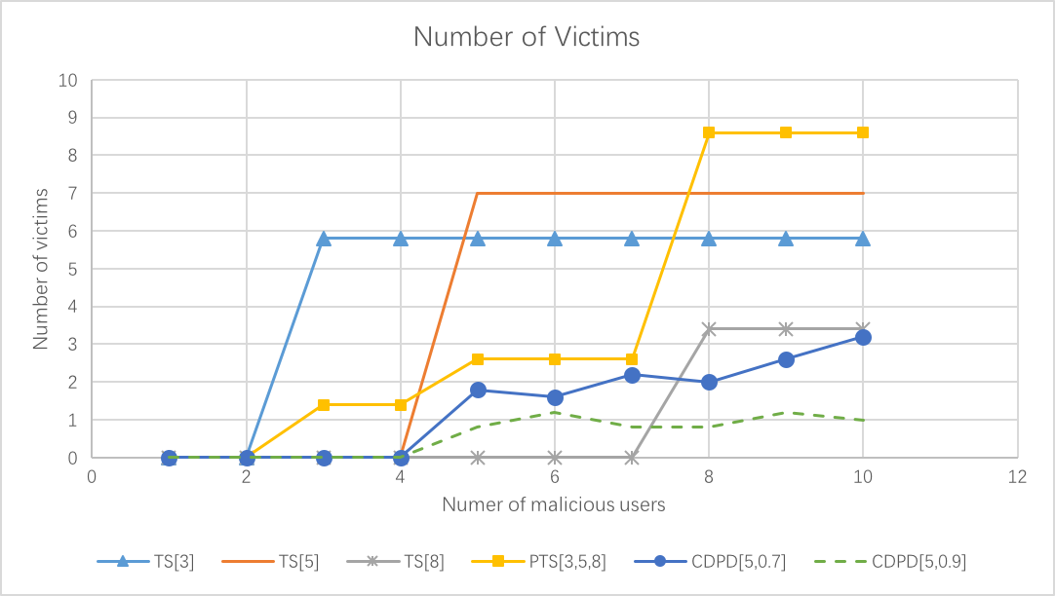
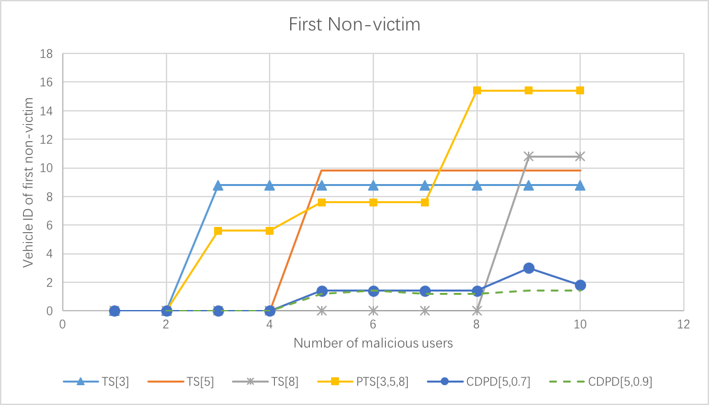
Result of simple map－－scenario two

Slide 37
Result of simple map－－scenario three
Number of road | 3
Number of intersection | 1
Number of normal vehicles | 100
Number of crash generator | 1
Number of malicious users | 1 ~ 10
Situation in the simulation | Fake negative warning
Crash duration time | Whole simulation
Percentage of the verified warning | 80%

Slide 38
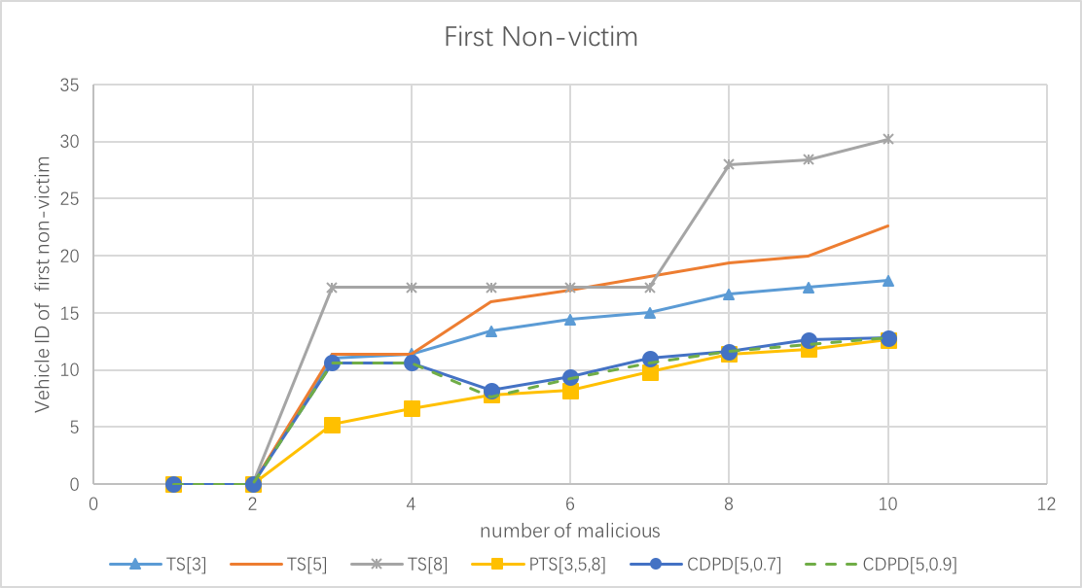
Result of simple map－－scenario three

Slide 39
Analysis
Without collusion team of malicious users, the less certificates the system needs the quicker the respond will be received.
Fake positive warning in an unobstructed road, rapid response mechanism causes the lack of alertness for normal vehicles.
Real warning with collusion team of malicious users which gives fake negative warning message, the number of collusion teams induce the congregate delay of responds.
The generate rule in this system, excessive trust both improving the efficiency of reflection and decreasing the credibility of the system.

Slide 40
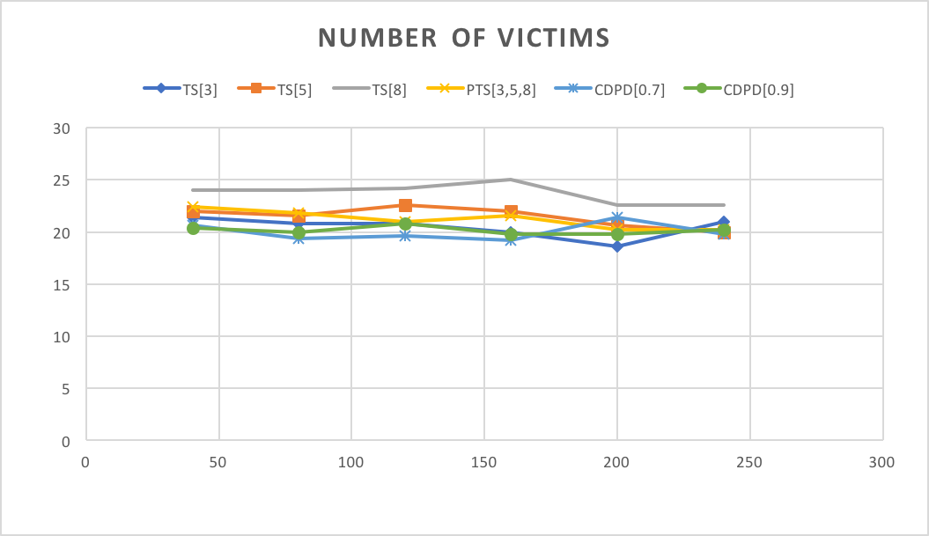
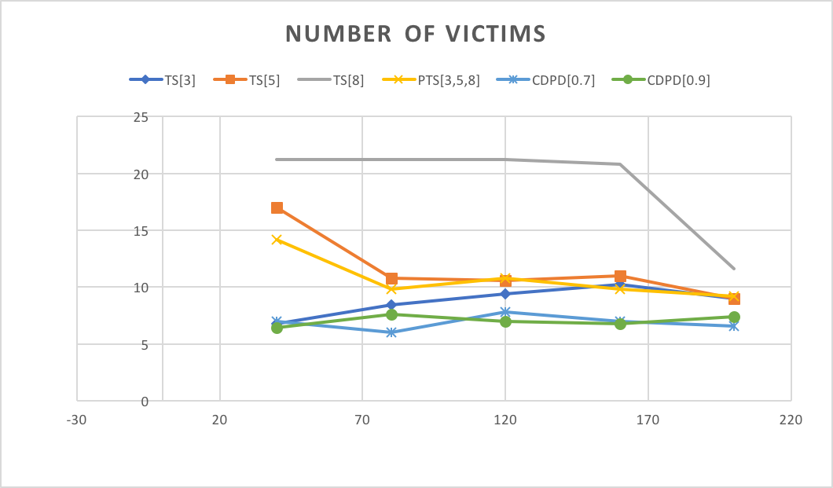
Observation of block map and real map

Slide 41
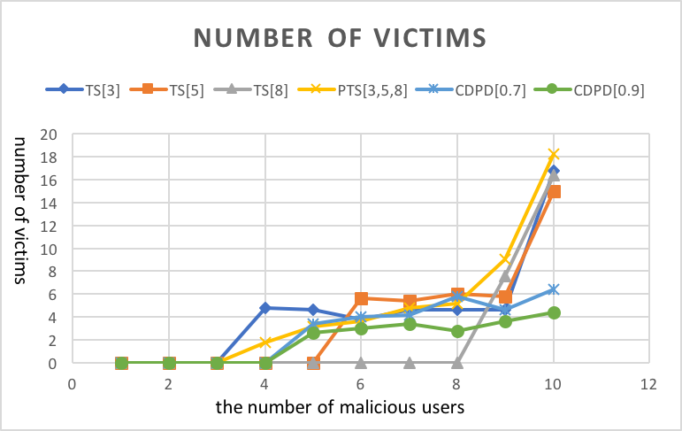
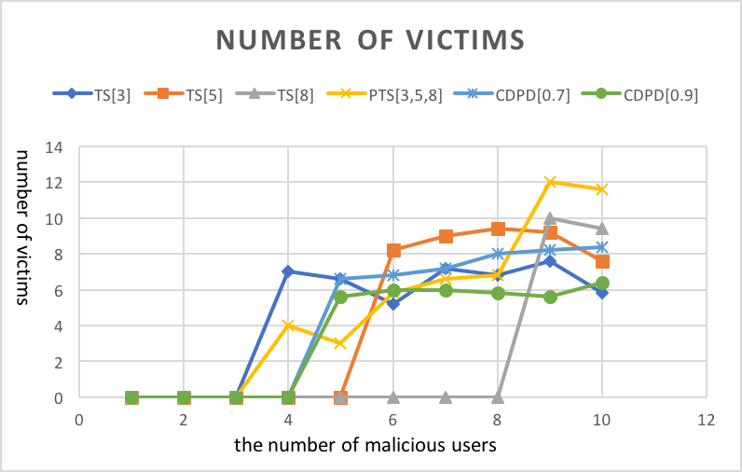
Observation of block map and real map

Slide 42
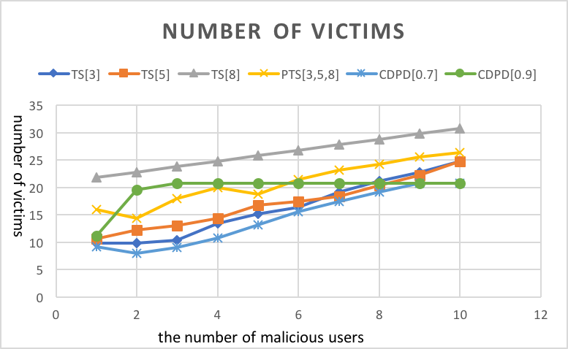
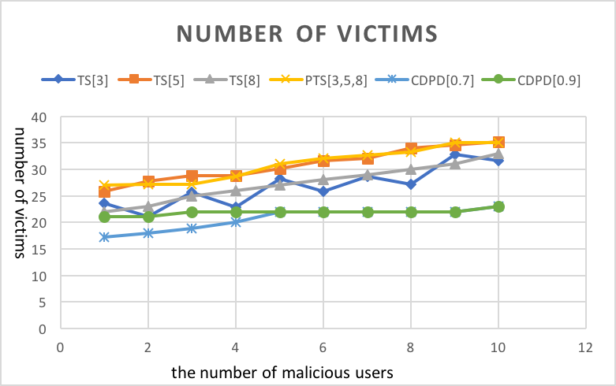
Observation of block map and real map

Slide 43
Observation
Limited by the length of road in real map is not long enough.
Traffic light might separates the random traffic flow into period of intensive traffic flow.
The red state of traffic light can create a positive message before the test vehicle arrive at crash position.
As the real map is more complex, the test vehicle has more choices to avoid the accident location.

Slide 44
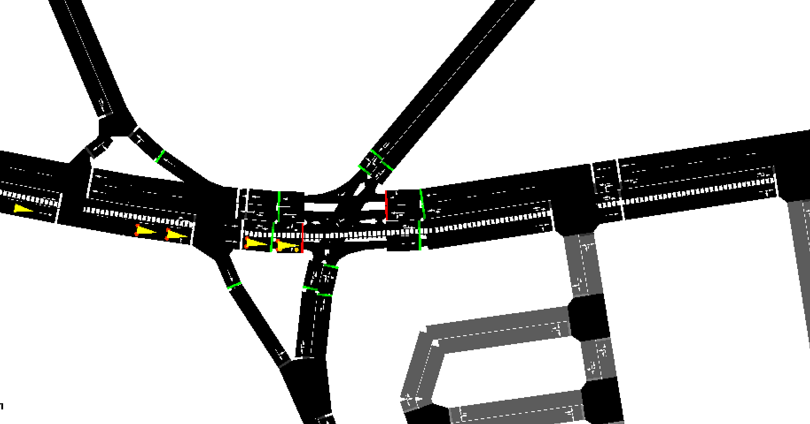
Future work
Traffic light

Slide 45
Q & A

Slide 46
Thank you !

Slide 47
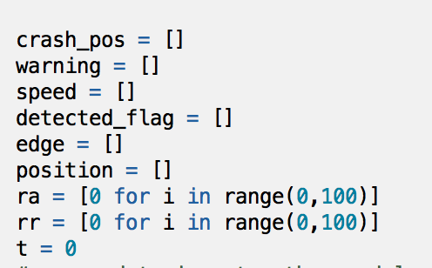
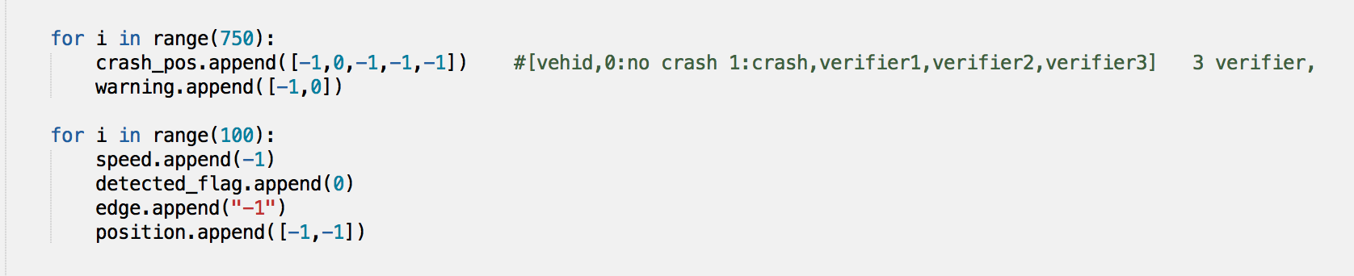

Slide 48
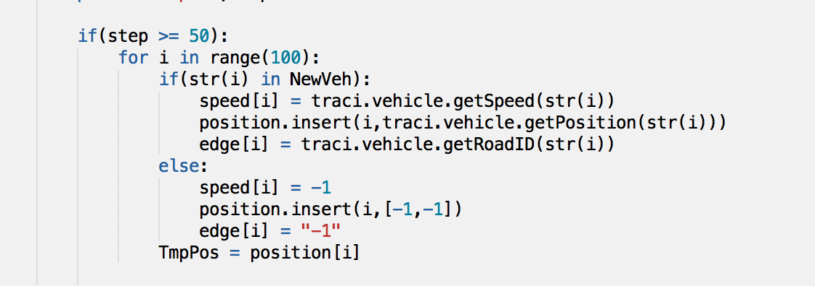
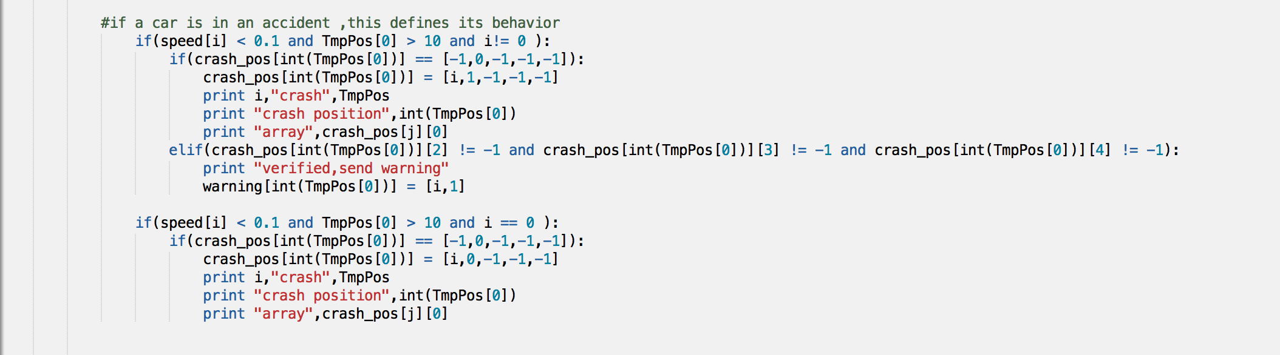

Slide 49
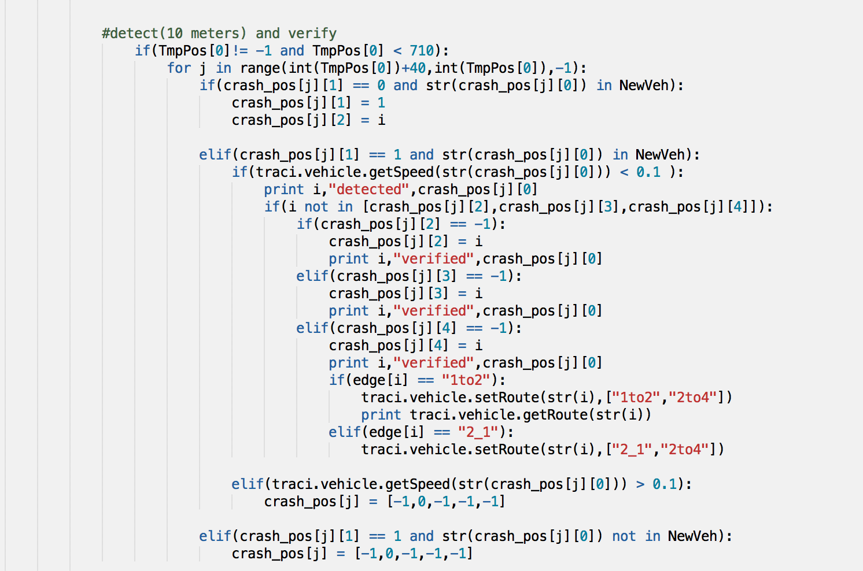

Slide 50
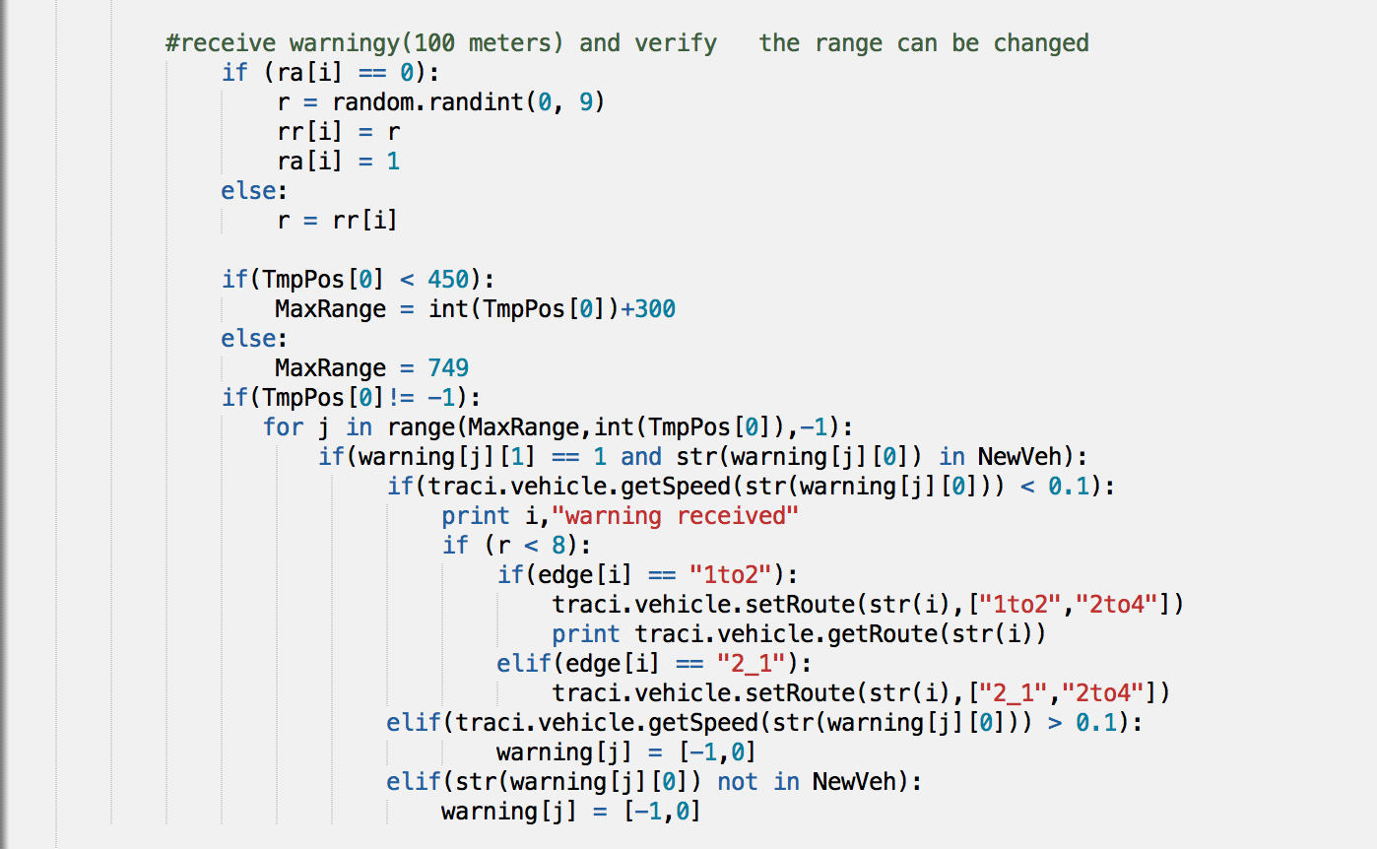

Slide 51
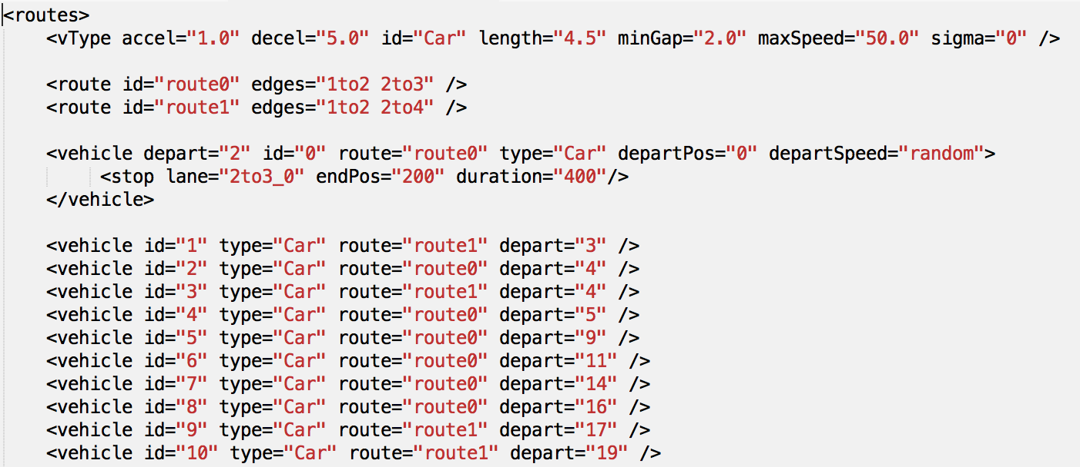

Slide 52
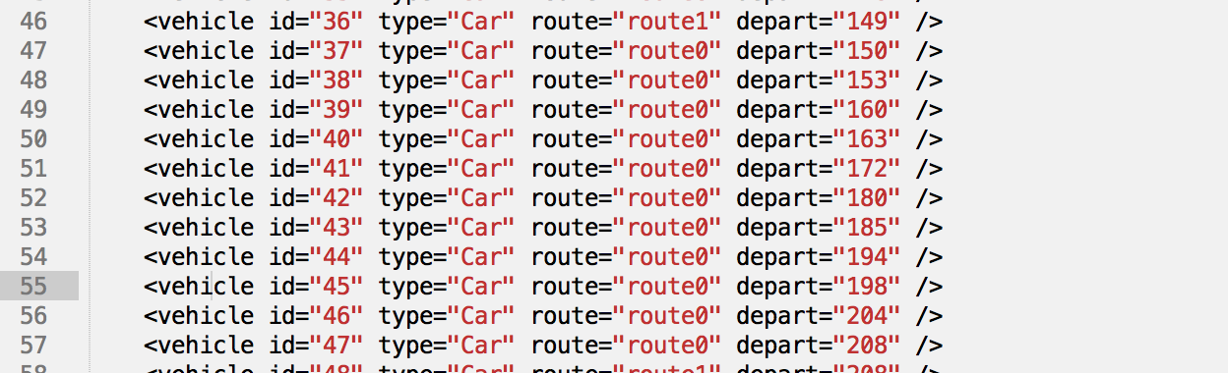
Further explanation

Slide 53
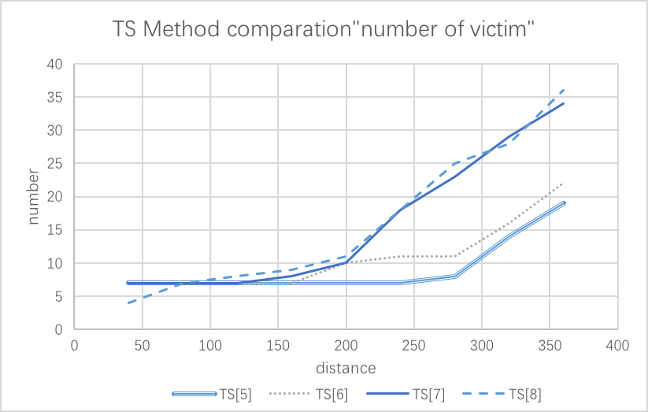
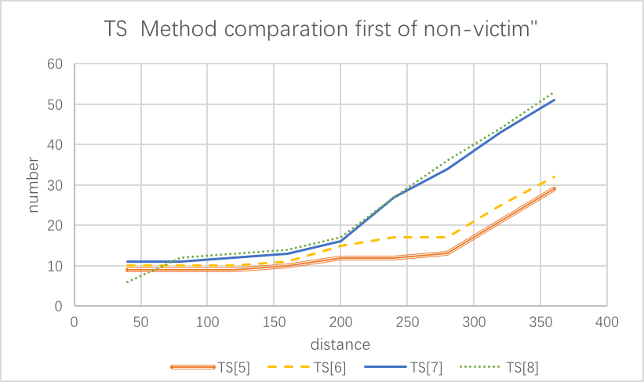
Further explanation

